Slide 1
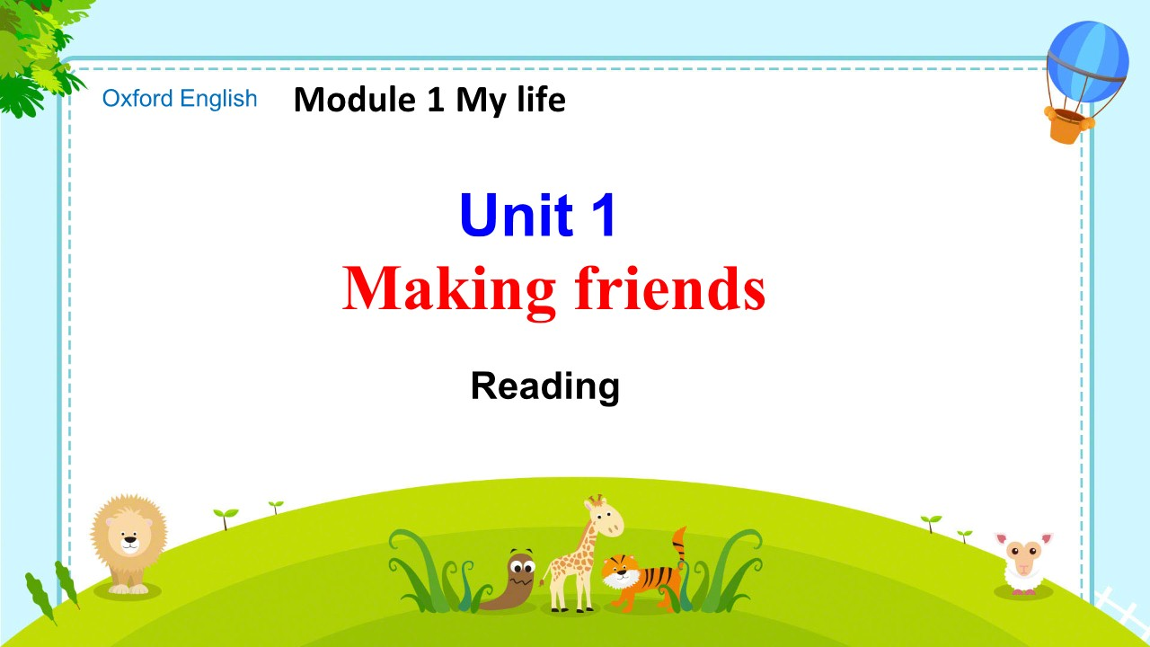

Slide 2

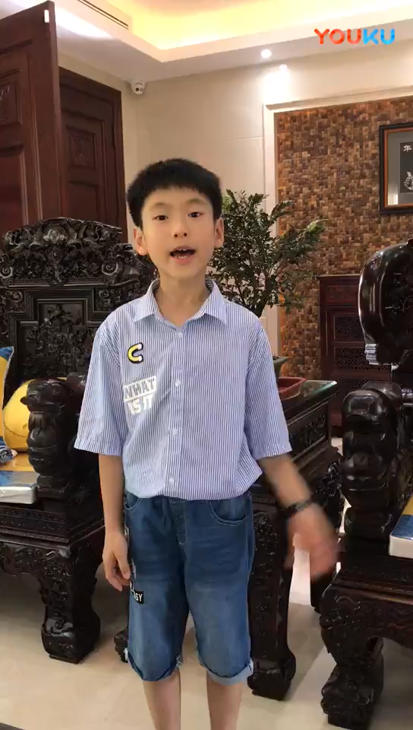
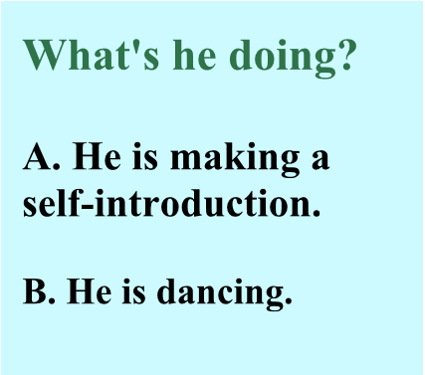

Slide 3
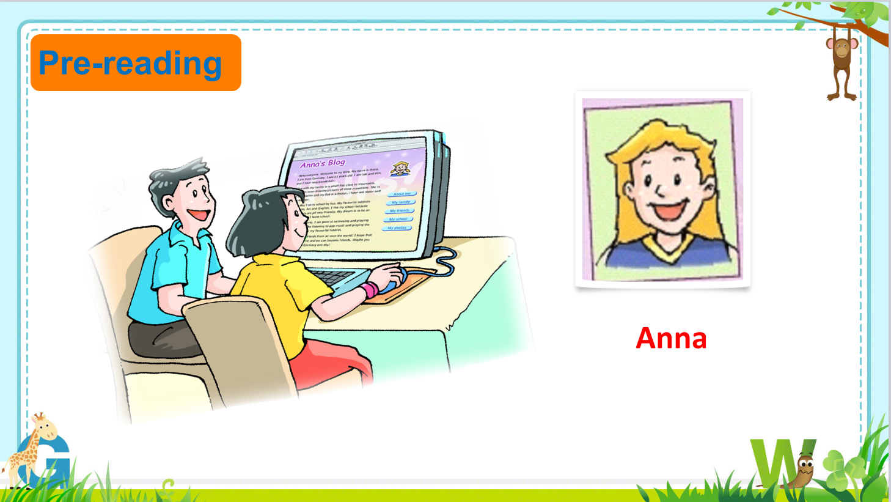

Slide 4
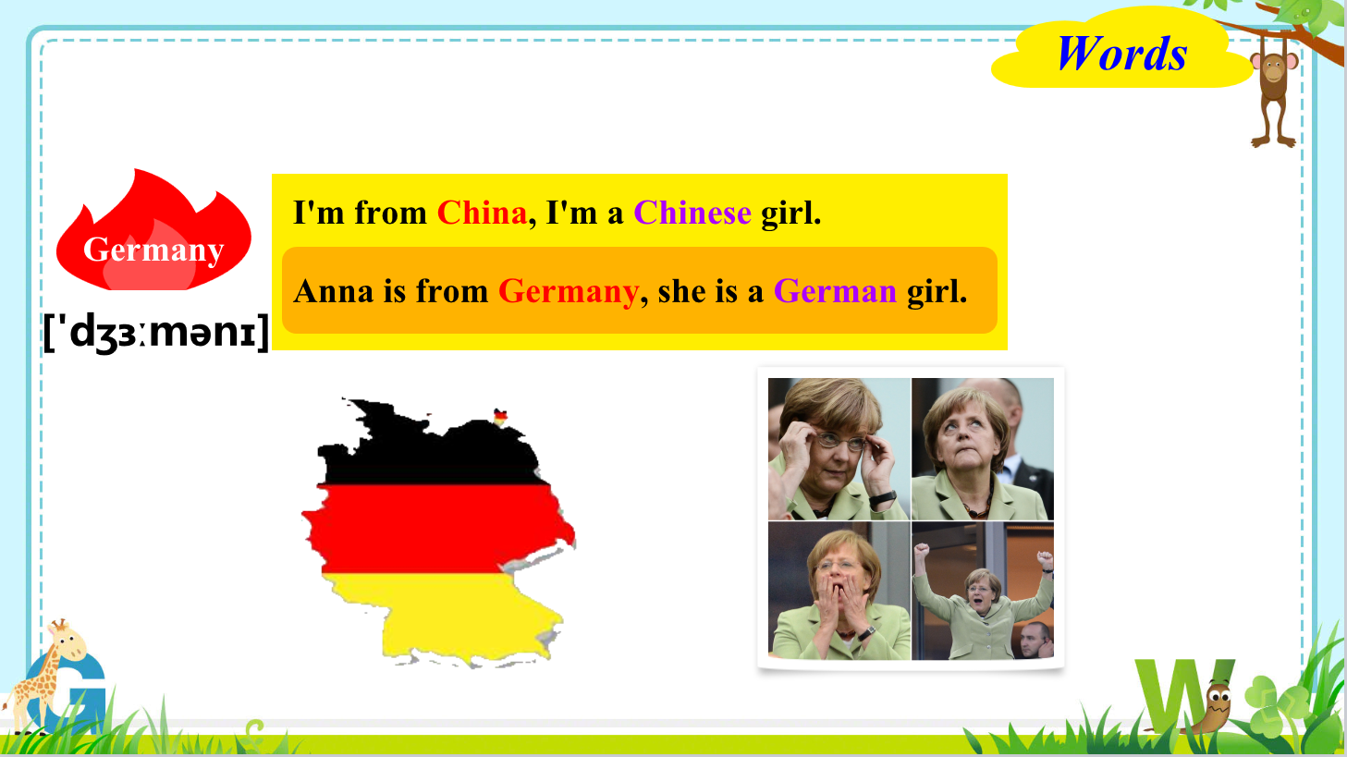

Slide 5
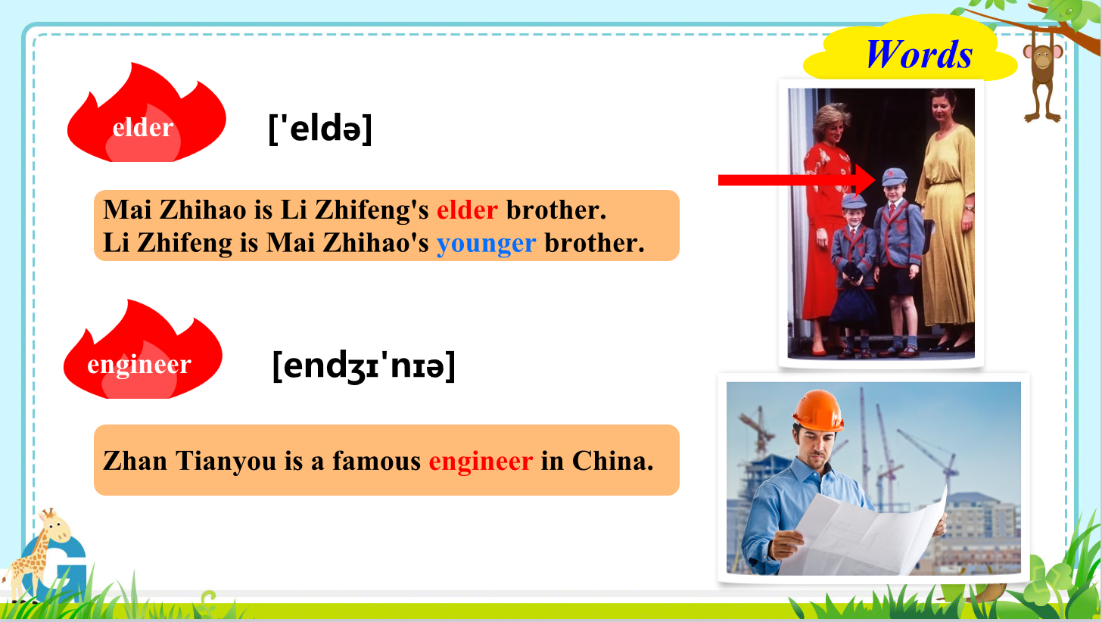

Slide 6
Vocabulary
C1 Here are some sentences from the blog on page 3. Do you know the meanings of the words in italics? Circle the correct answers.
1 Hello everyone.
a all people b some people
2 I live with my family in a house close to some mountains.
a near b far away from
3 I like my school because the teachers are all very friendly.
a happy b nice and kind
4 These are my favourite hobbies.
a things I must do b things I like doing in my free time
5 I want to make friends with young people from all over the world!
a some countries in b every country in

Slide 7
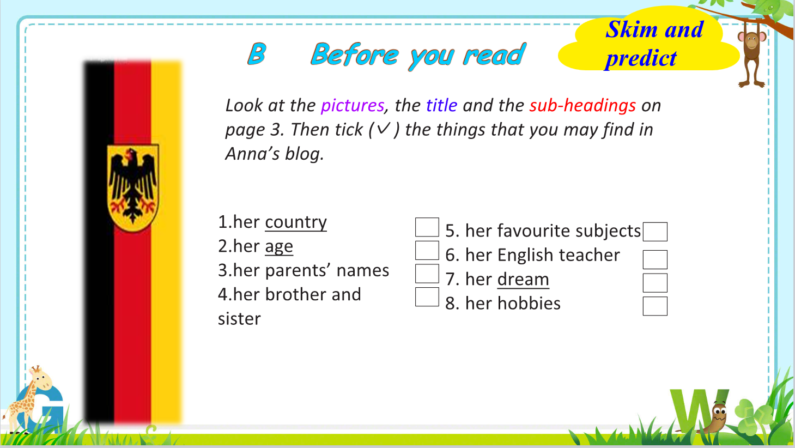

Slide 8
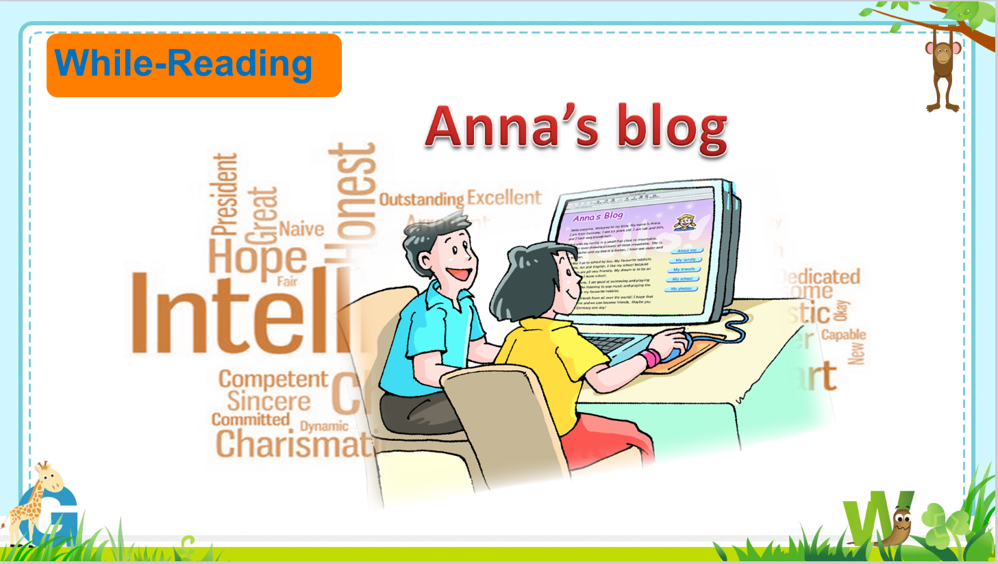

Slide 9
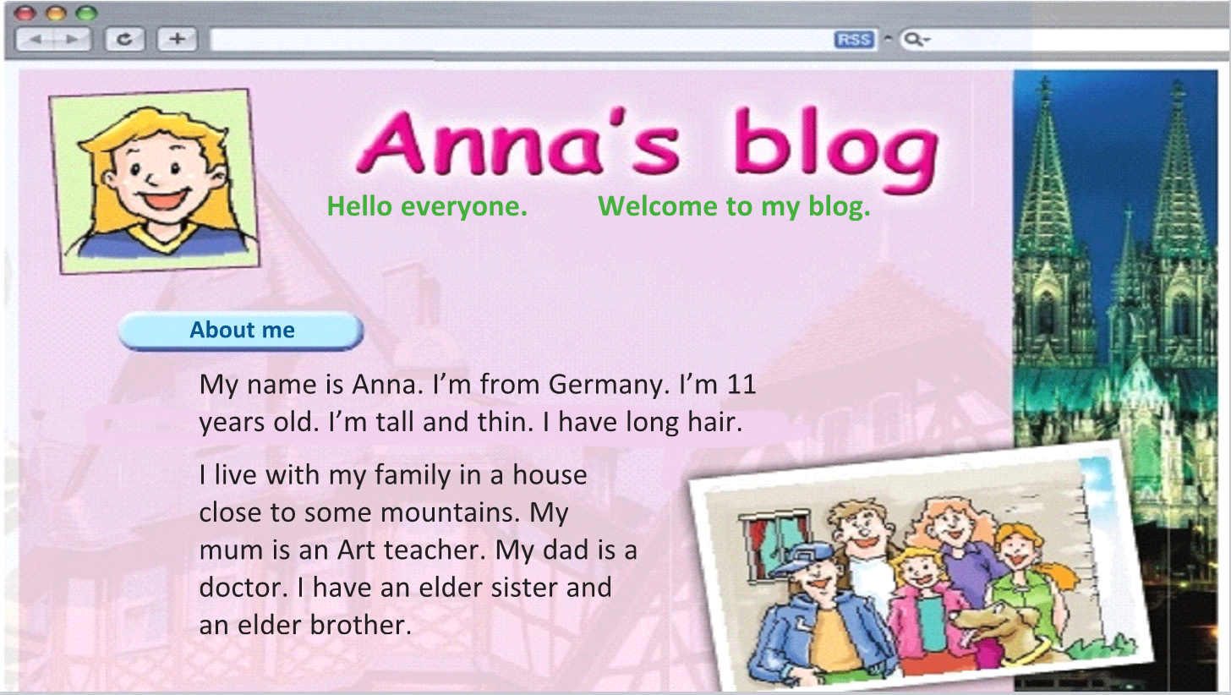


Slide 10
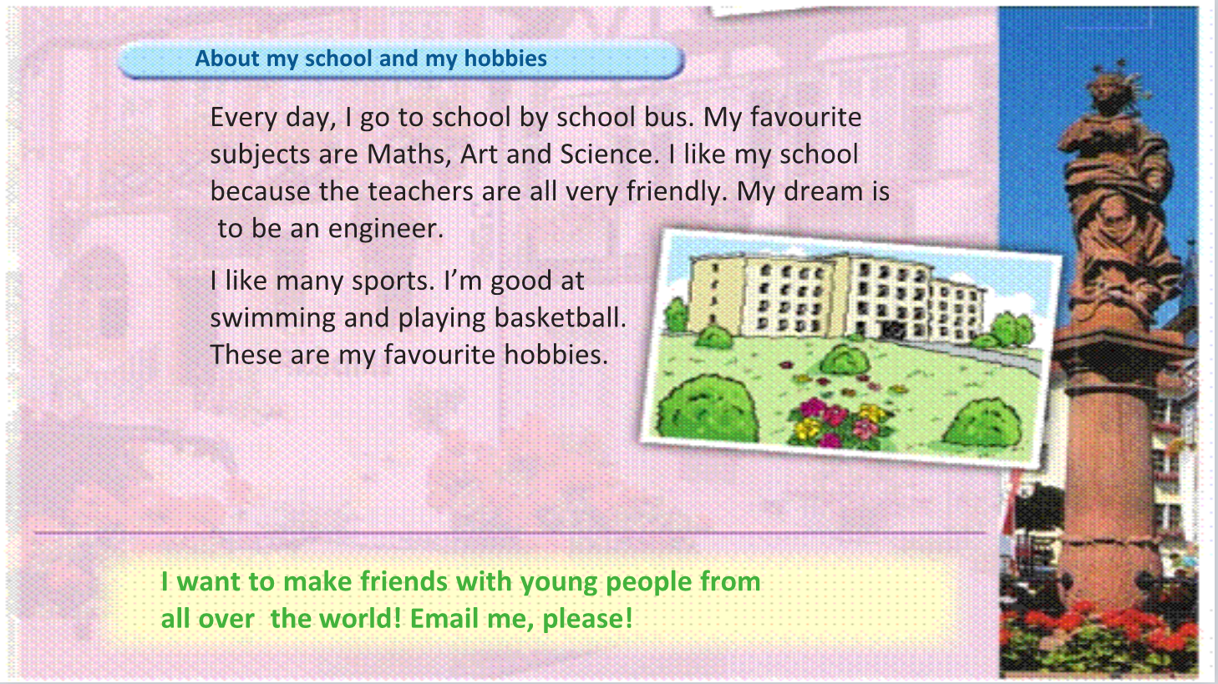

Slide 11
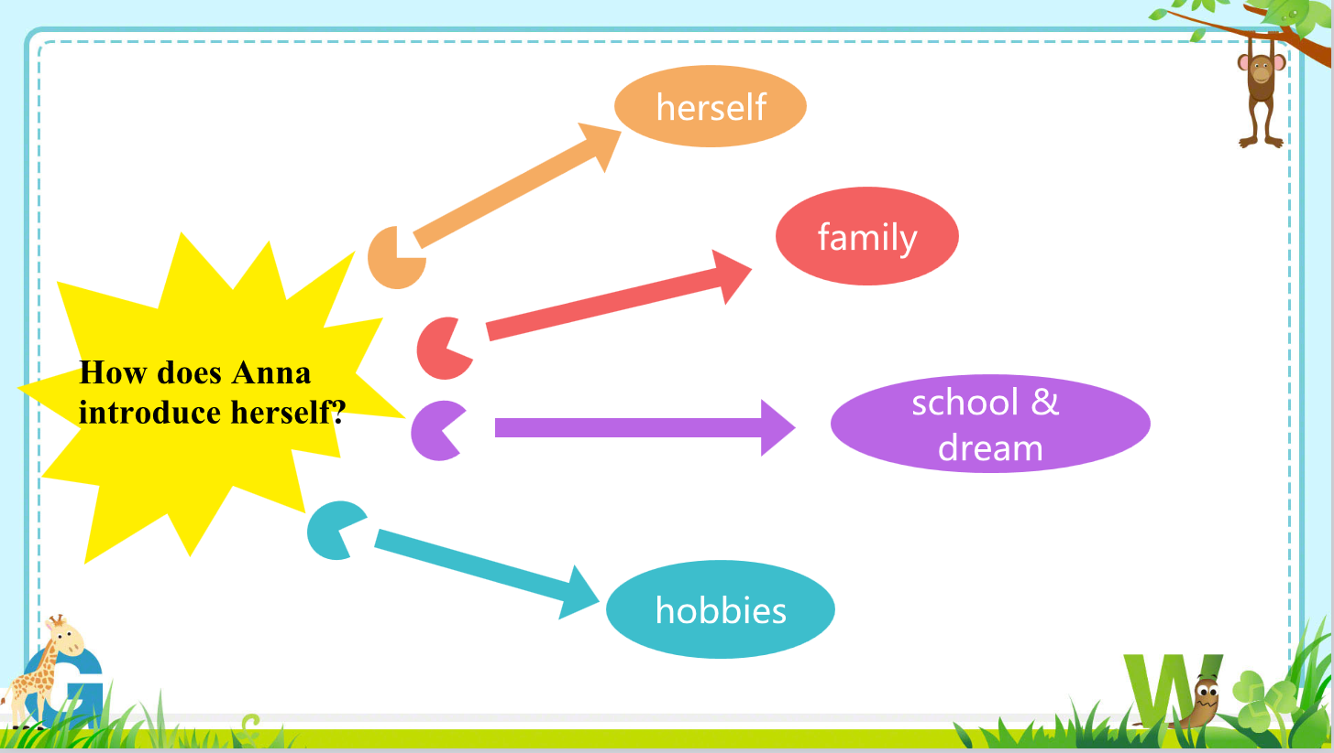

Slide 12
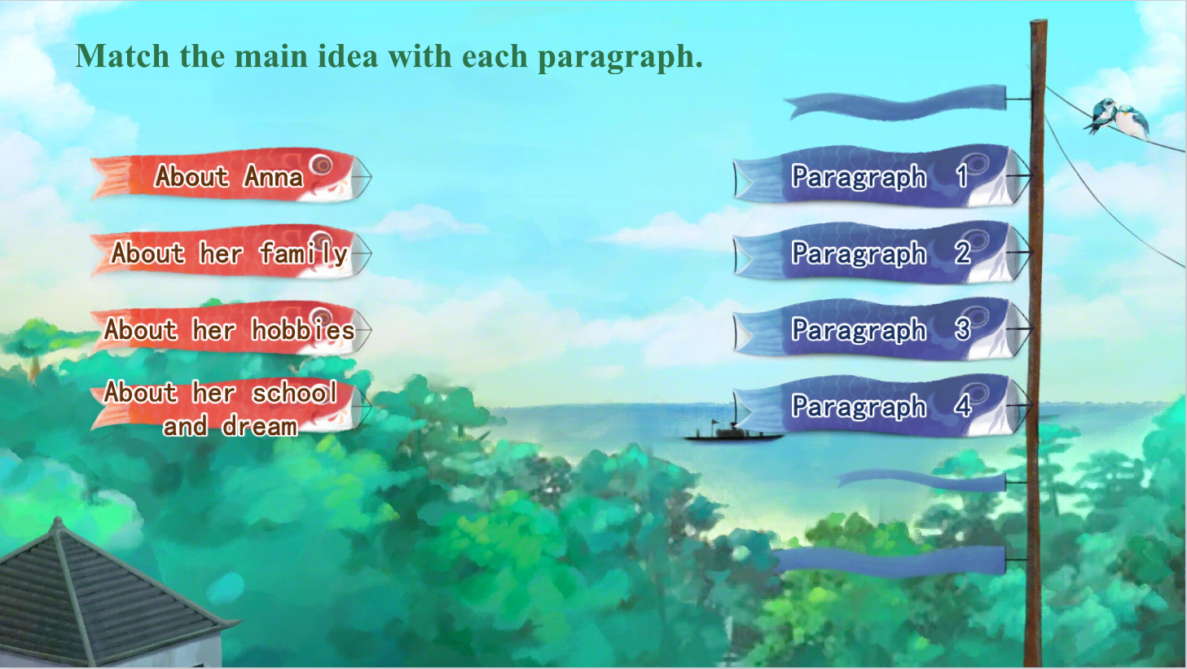

Slide 13
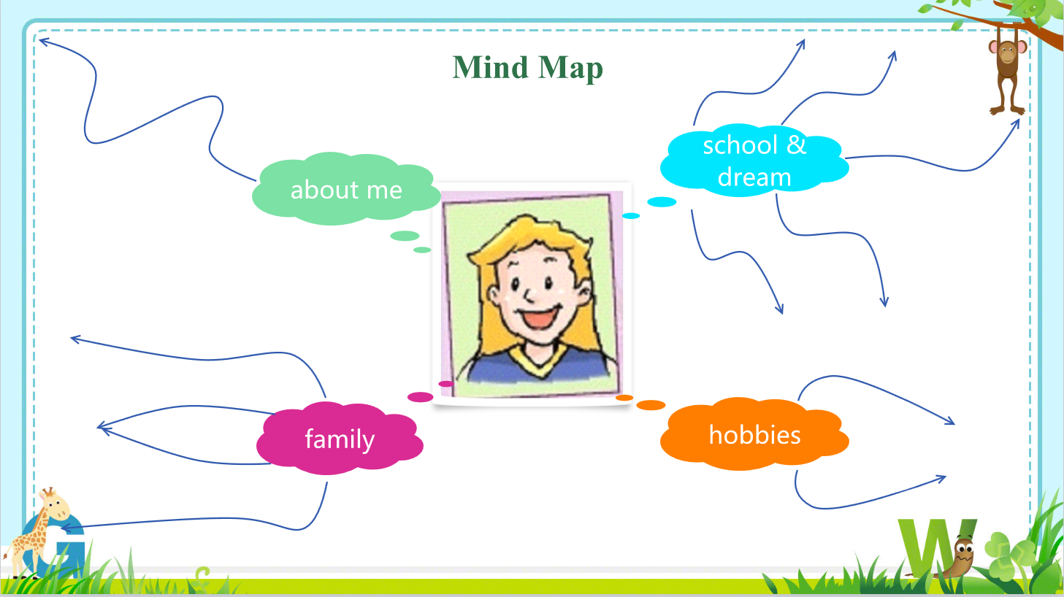

Slide 14
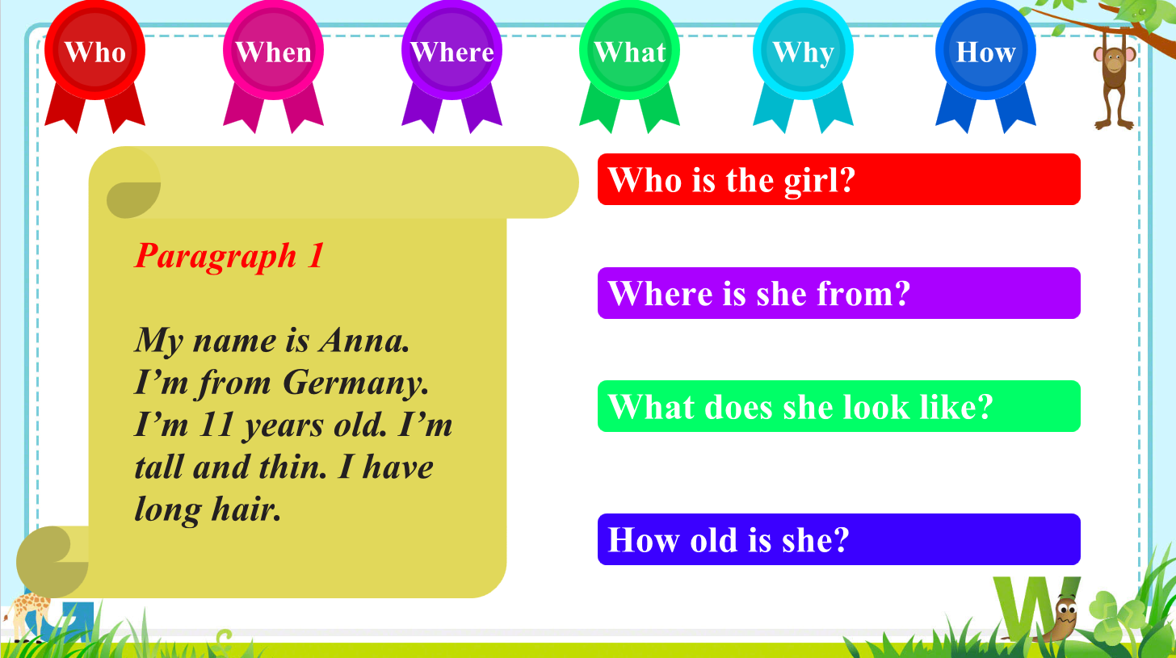
Anna
She is from Germany.
She is tall and thin with long hair.
She is 11 years old.

Slide 15
long hair
11
Germany
tall & thin
Anna

Slide 16
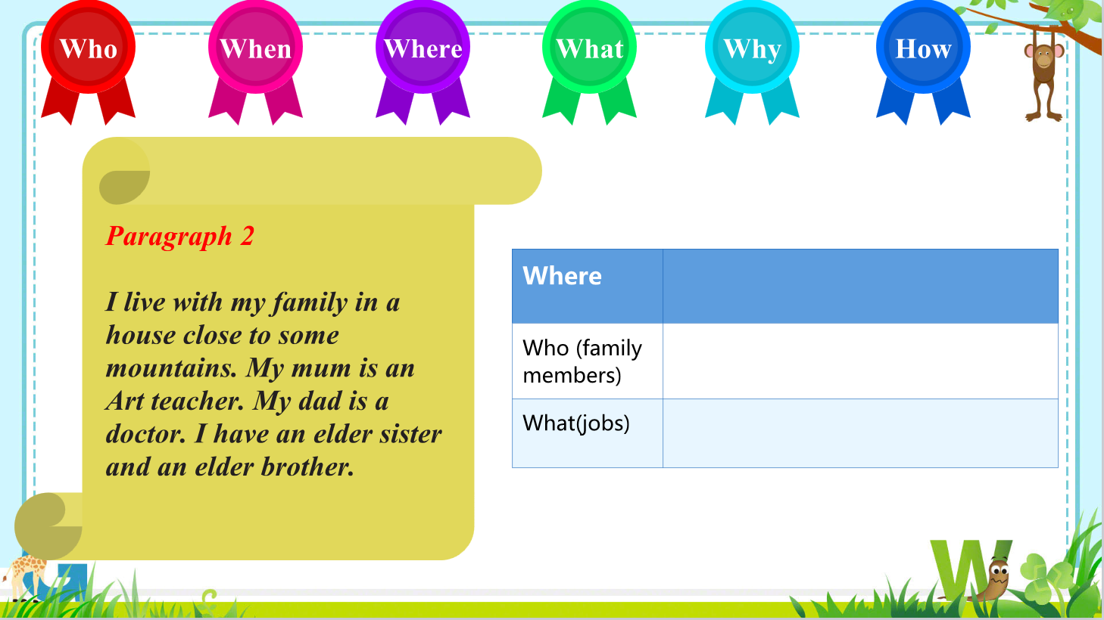
a house close to some mountains
mum, dad, an elder sister and an elder brother
Art teacher (mum)
doctor (dad)

Slide 17
long hair
11
Germany
tall & thin
Anna
Art teacher
mum
sister
brother
doctor
dad

Slide 18
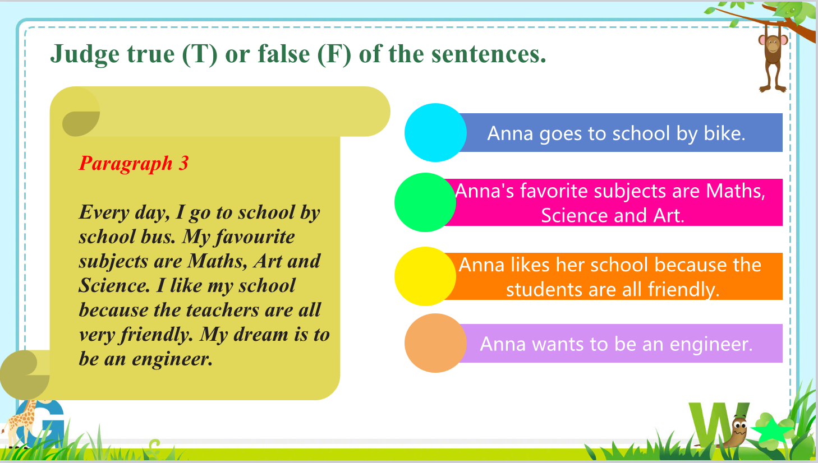
F
T
F
T

Slide 19
long hair
Science
11
Art
bus
Germany
Maths
tall & thin
Anna
like school
friendly
engineer
Art teacher
mum
sister
brother
doctor
dad

Slide 20
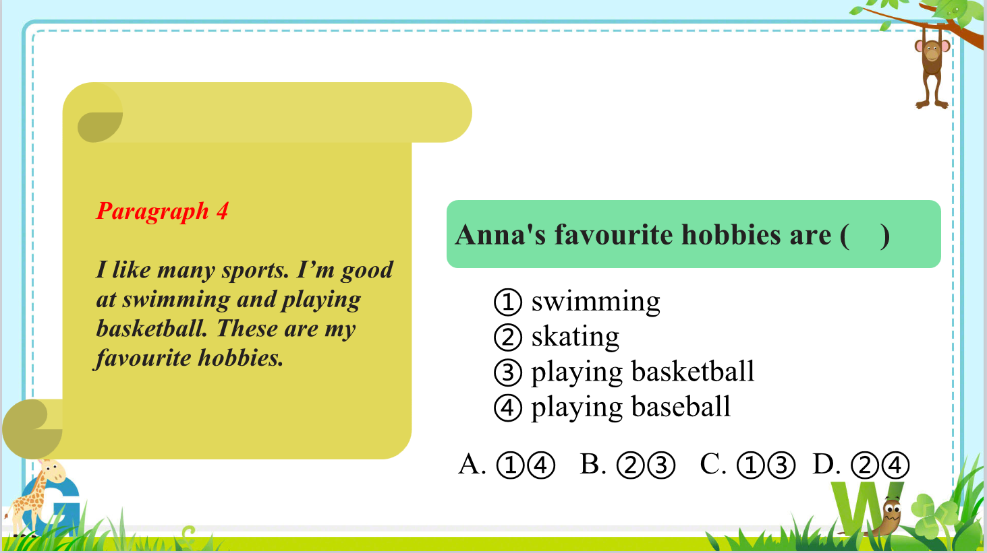
C

Slide 21
long hair
Science
11
Art
bus
Germany
Maths
tall & thin
Anna
like school
friendly
engineer
Art teacher
mum
swimming
sister
brother
dad
basketball
doctor

Slide 22

Look at the pictures, the title and the sub-headings on page 3. Then tick (✓) the things that you may find in Anna’s blog.
1.her country
2.her age
3.her parents’ names
4.her brother and sister
5. her favourite subjects
6. her English teacher
7. her dream
8. her hobbies
✓
✓
✓
✓
✓
✓

Slide 23
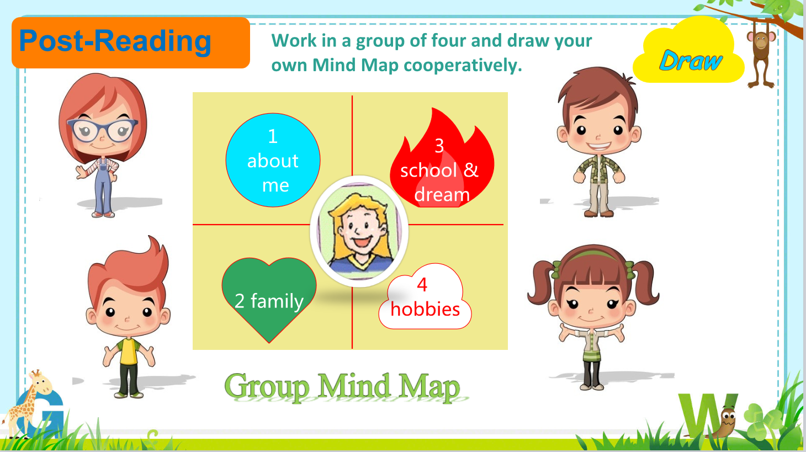

Slide 24
